Slide 1

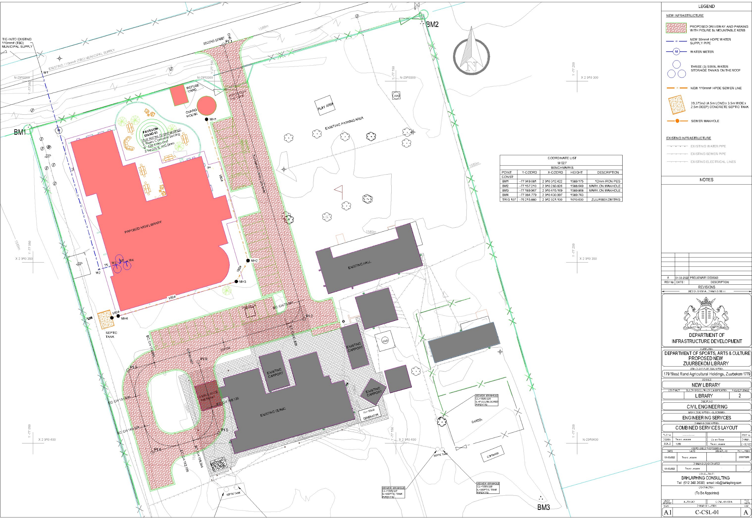
PROJECT DATA SHEET
ZUURBEKOM LIBRARY
Client Details:
Name: Bosele Consulting
Contact Person: Tlamelo Gulubane
Project Details:
Problem Statement:
A new library for the community of Zuurbekom
Client Brief:
A community library based on a new concept of Libraries of the future.
The Solution:
A 1800m2 library
Engineering Disciplines: Civil and Structural Engineering Services
Responsibilities: Engineering Designs (Inception and Preliminary designs only)
Location: Nigel, Gauteng
Project Value: R25 000 000.00
Project Duration: Twenty-Four Months
Completed: Scheduled to be completed in February 2025
COMBINED SERVICES LAYOUT

Slide 2
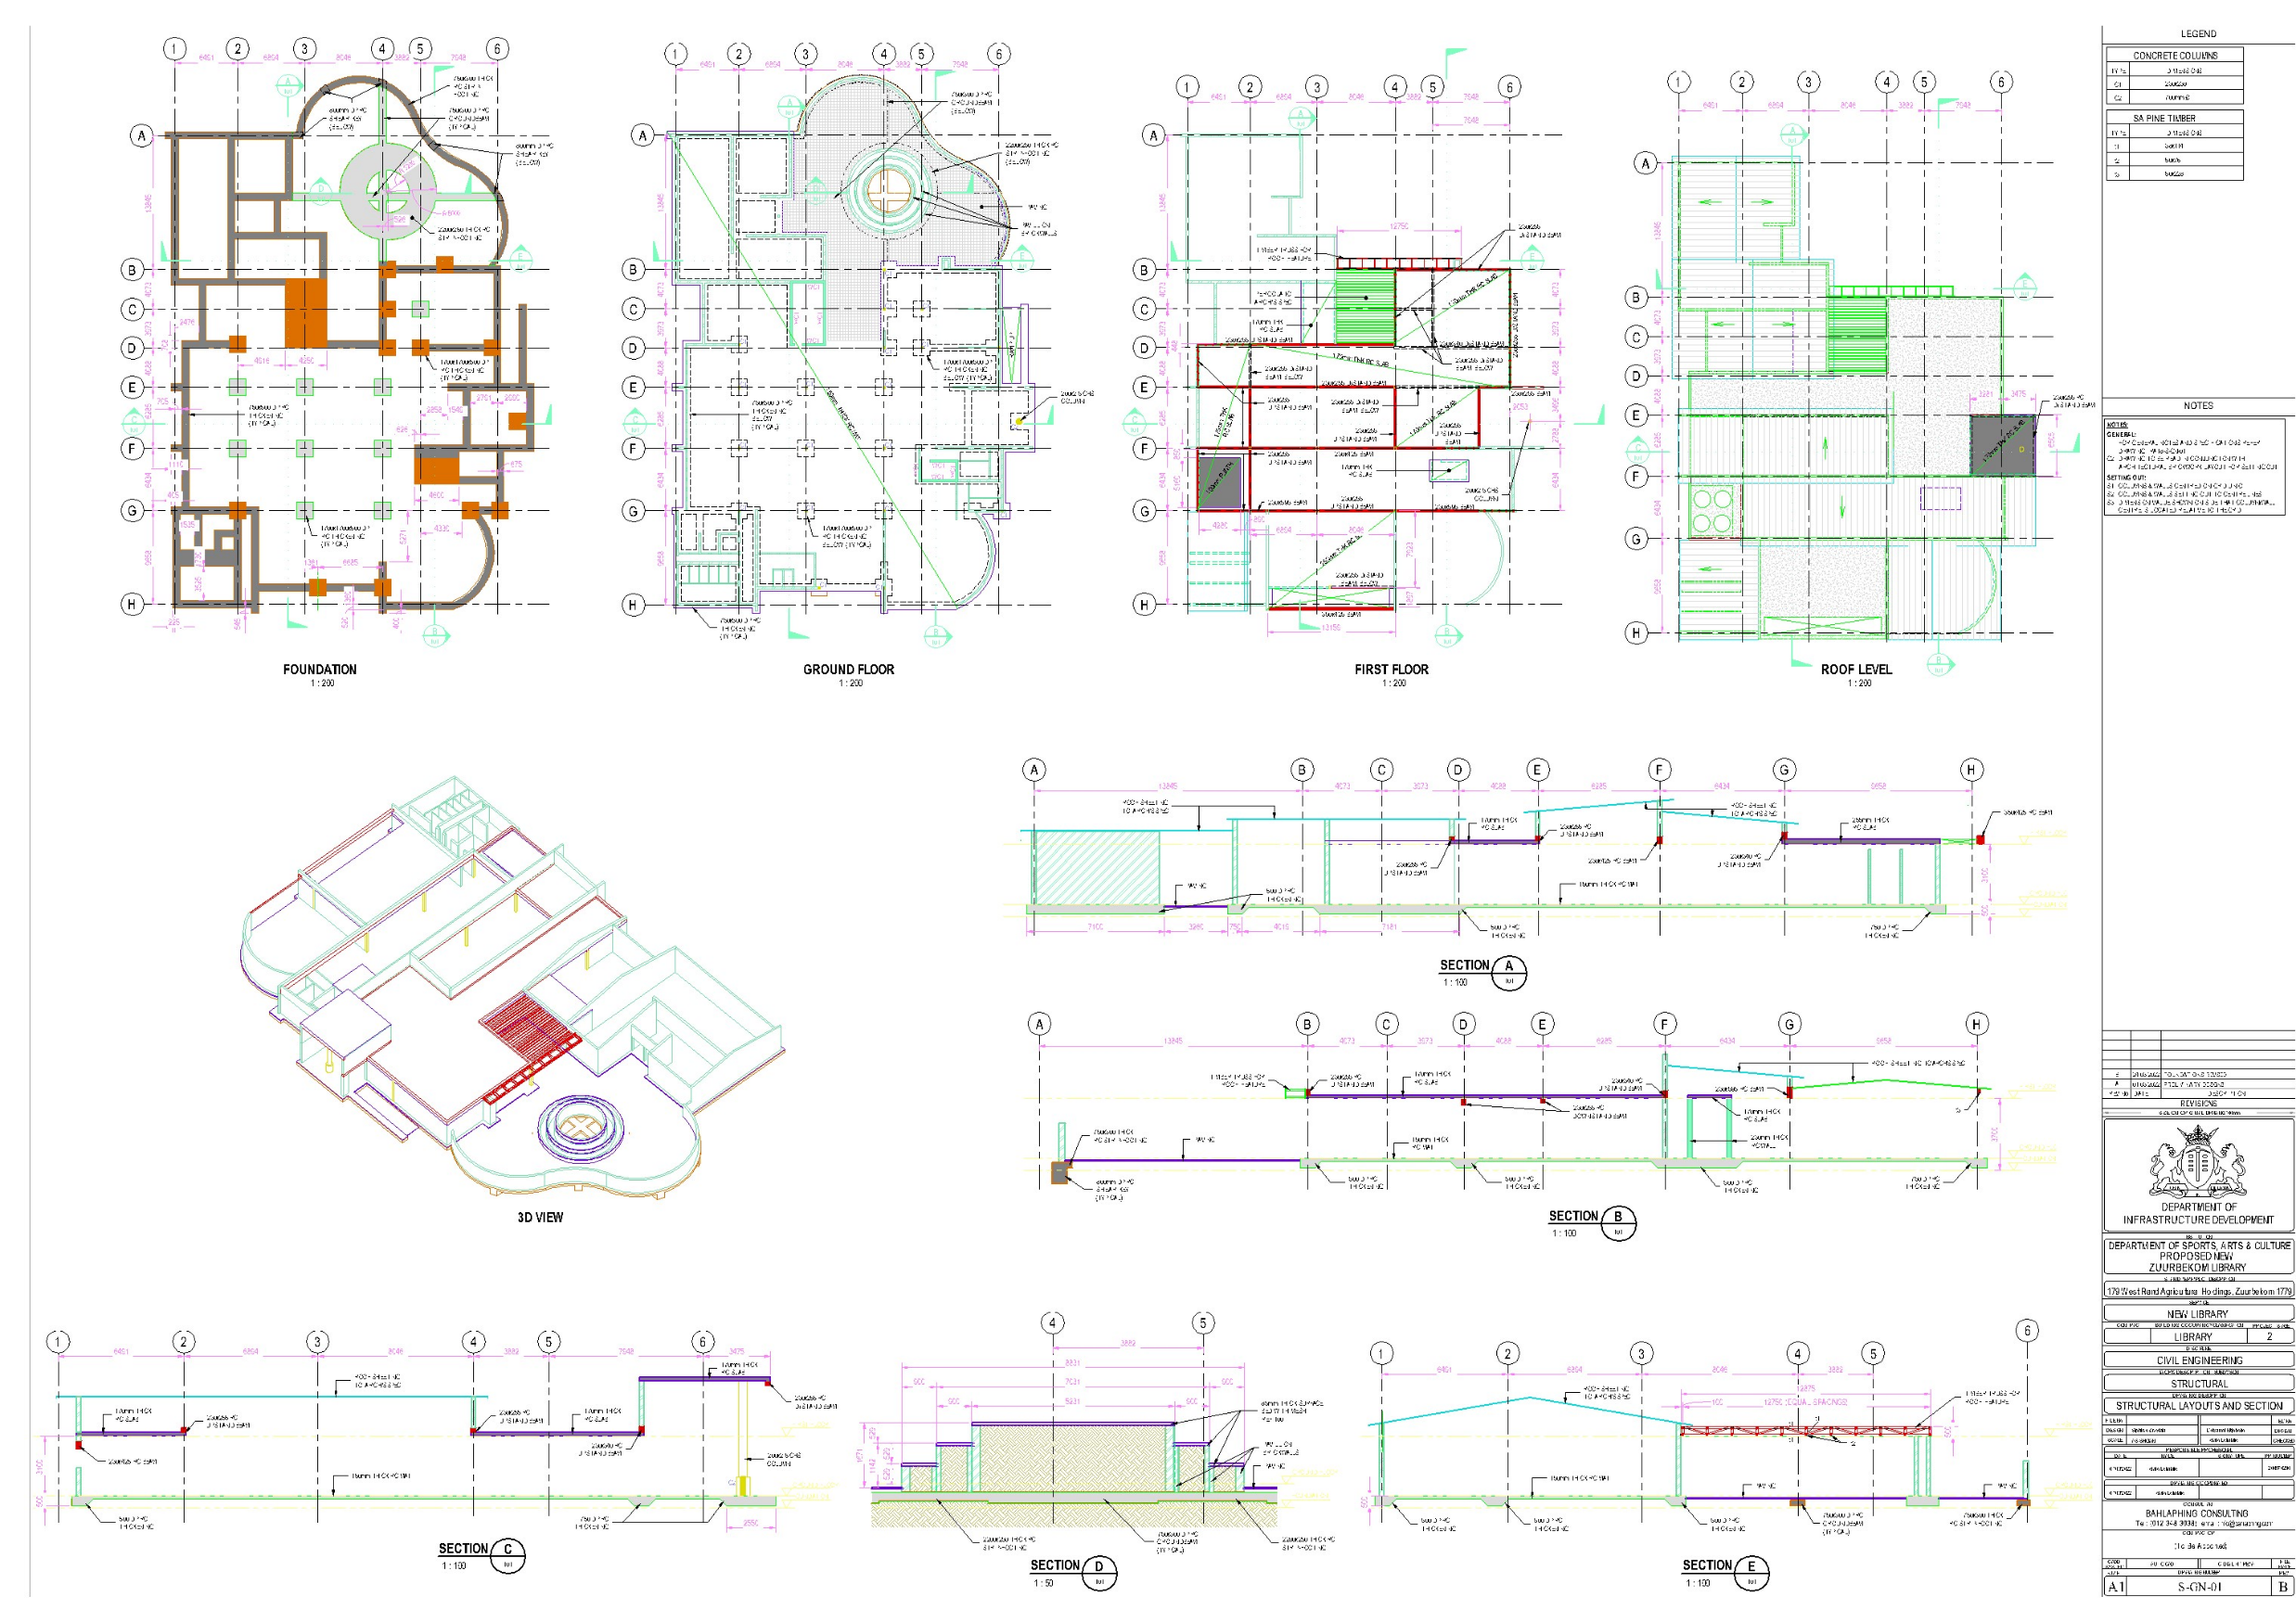
PROJECT DATA SHEET
ZUURBEKOM LIBRARY
STRUCTURAL ENGINEERING

