Slide 1

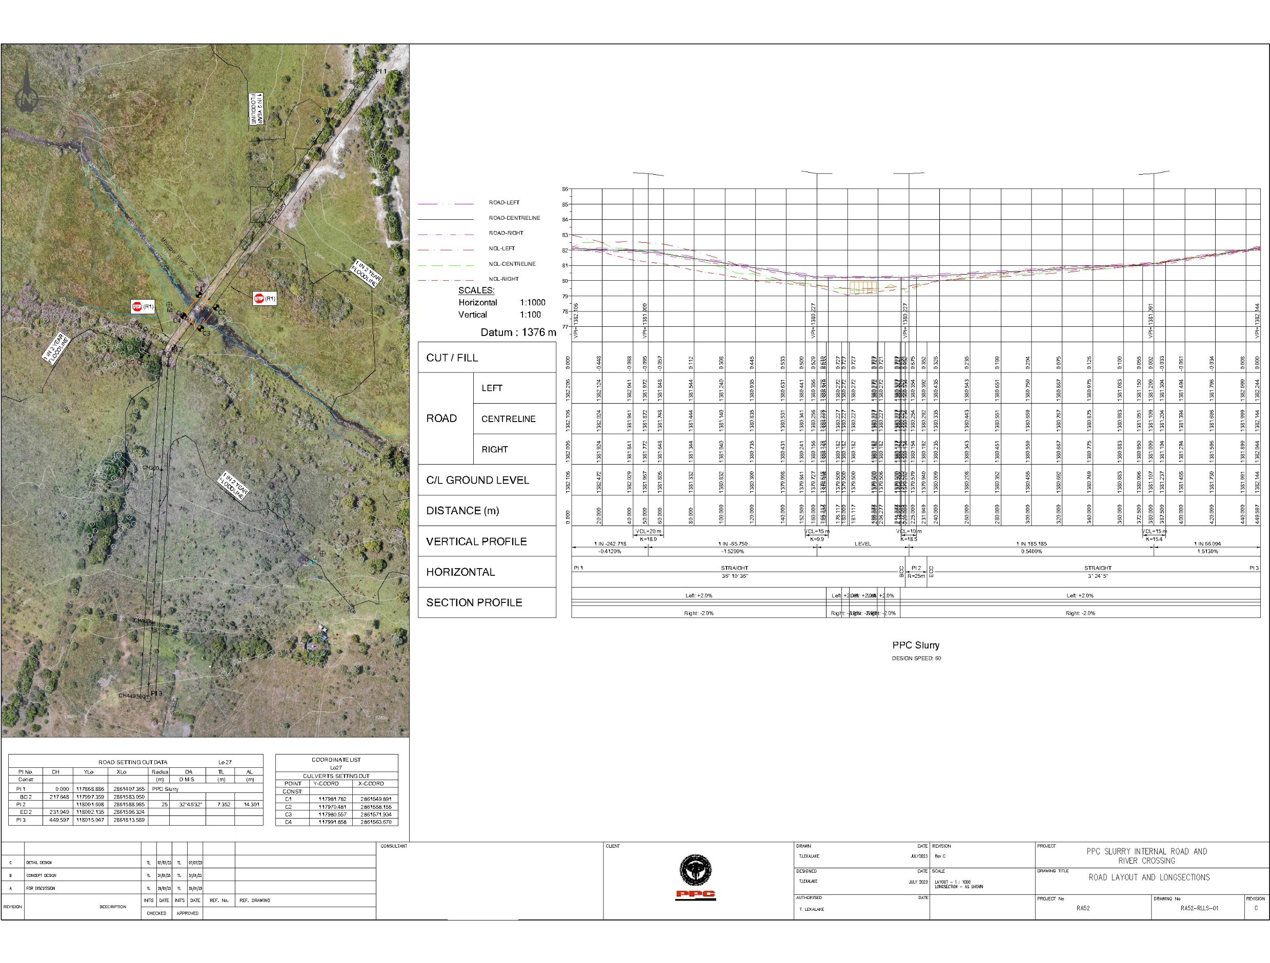
PROJECT DATA SHEET
PPC RIVER CROSSING AND CULLINAN MINE STORMWATER MANAGEMENT
Client Details:
Name: Isowel Trading and Project
Contact Person: Moleseng Tlaila
Contact No.: 072 145 3735
Project Details:
Problem Statement:
PPC will be mining a new area within their mining rights area but an existing river prevents access to the site, while Cullinan mine has to deal with large volumes of stormwater that flows into the pit, which needs to be avoided.
Client Brief:
Preliminary, detail design and construction of a river crossing, and stormwater diversion away from the pit.
The Solution:
A low-level river crossing which will be allowed to flood.
Stormwater dams and a pump system to divert surface water away from the pit.
Engineering Disciplines: Civil Engineering
Responsibilities: Engineering Designs and Technical Support during Construction
Location: PPC Slurry in Northwest and Cullinan Mine in Gauteng
Project Value: R18 000 000.00
Project Duration: Ten Months
Completed: Scheduled to be completed in July 2023
PPC RIVER DIVERSION LAYOUT PLAN AND LONGSECTION

Slide 2
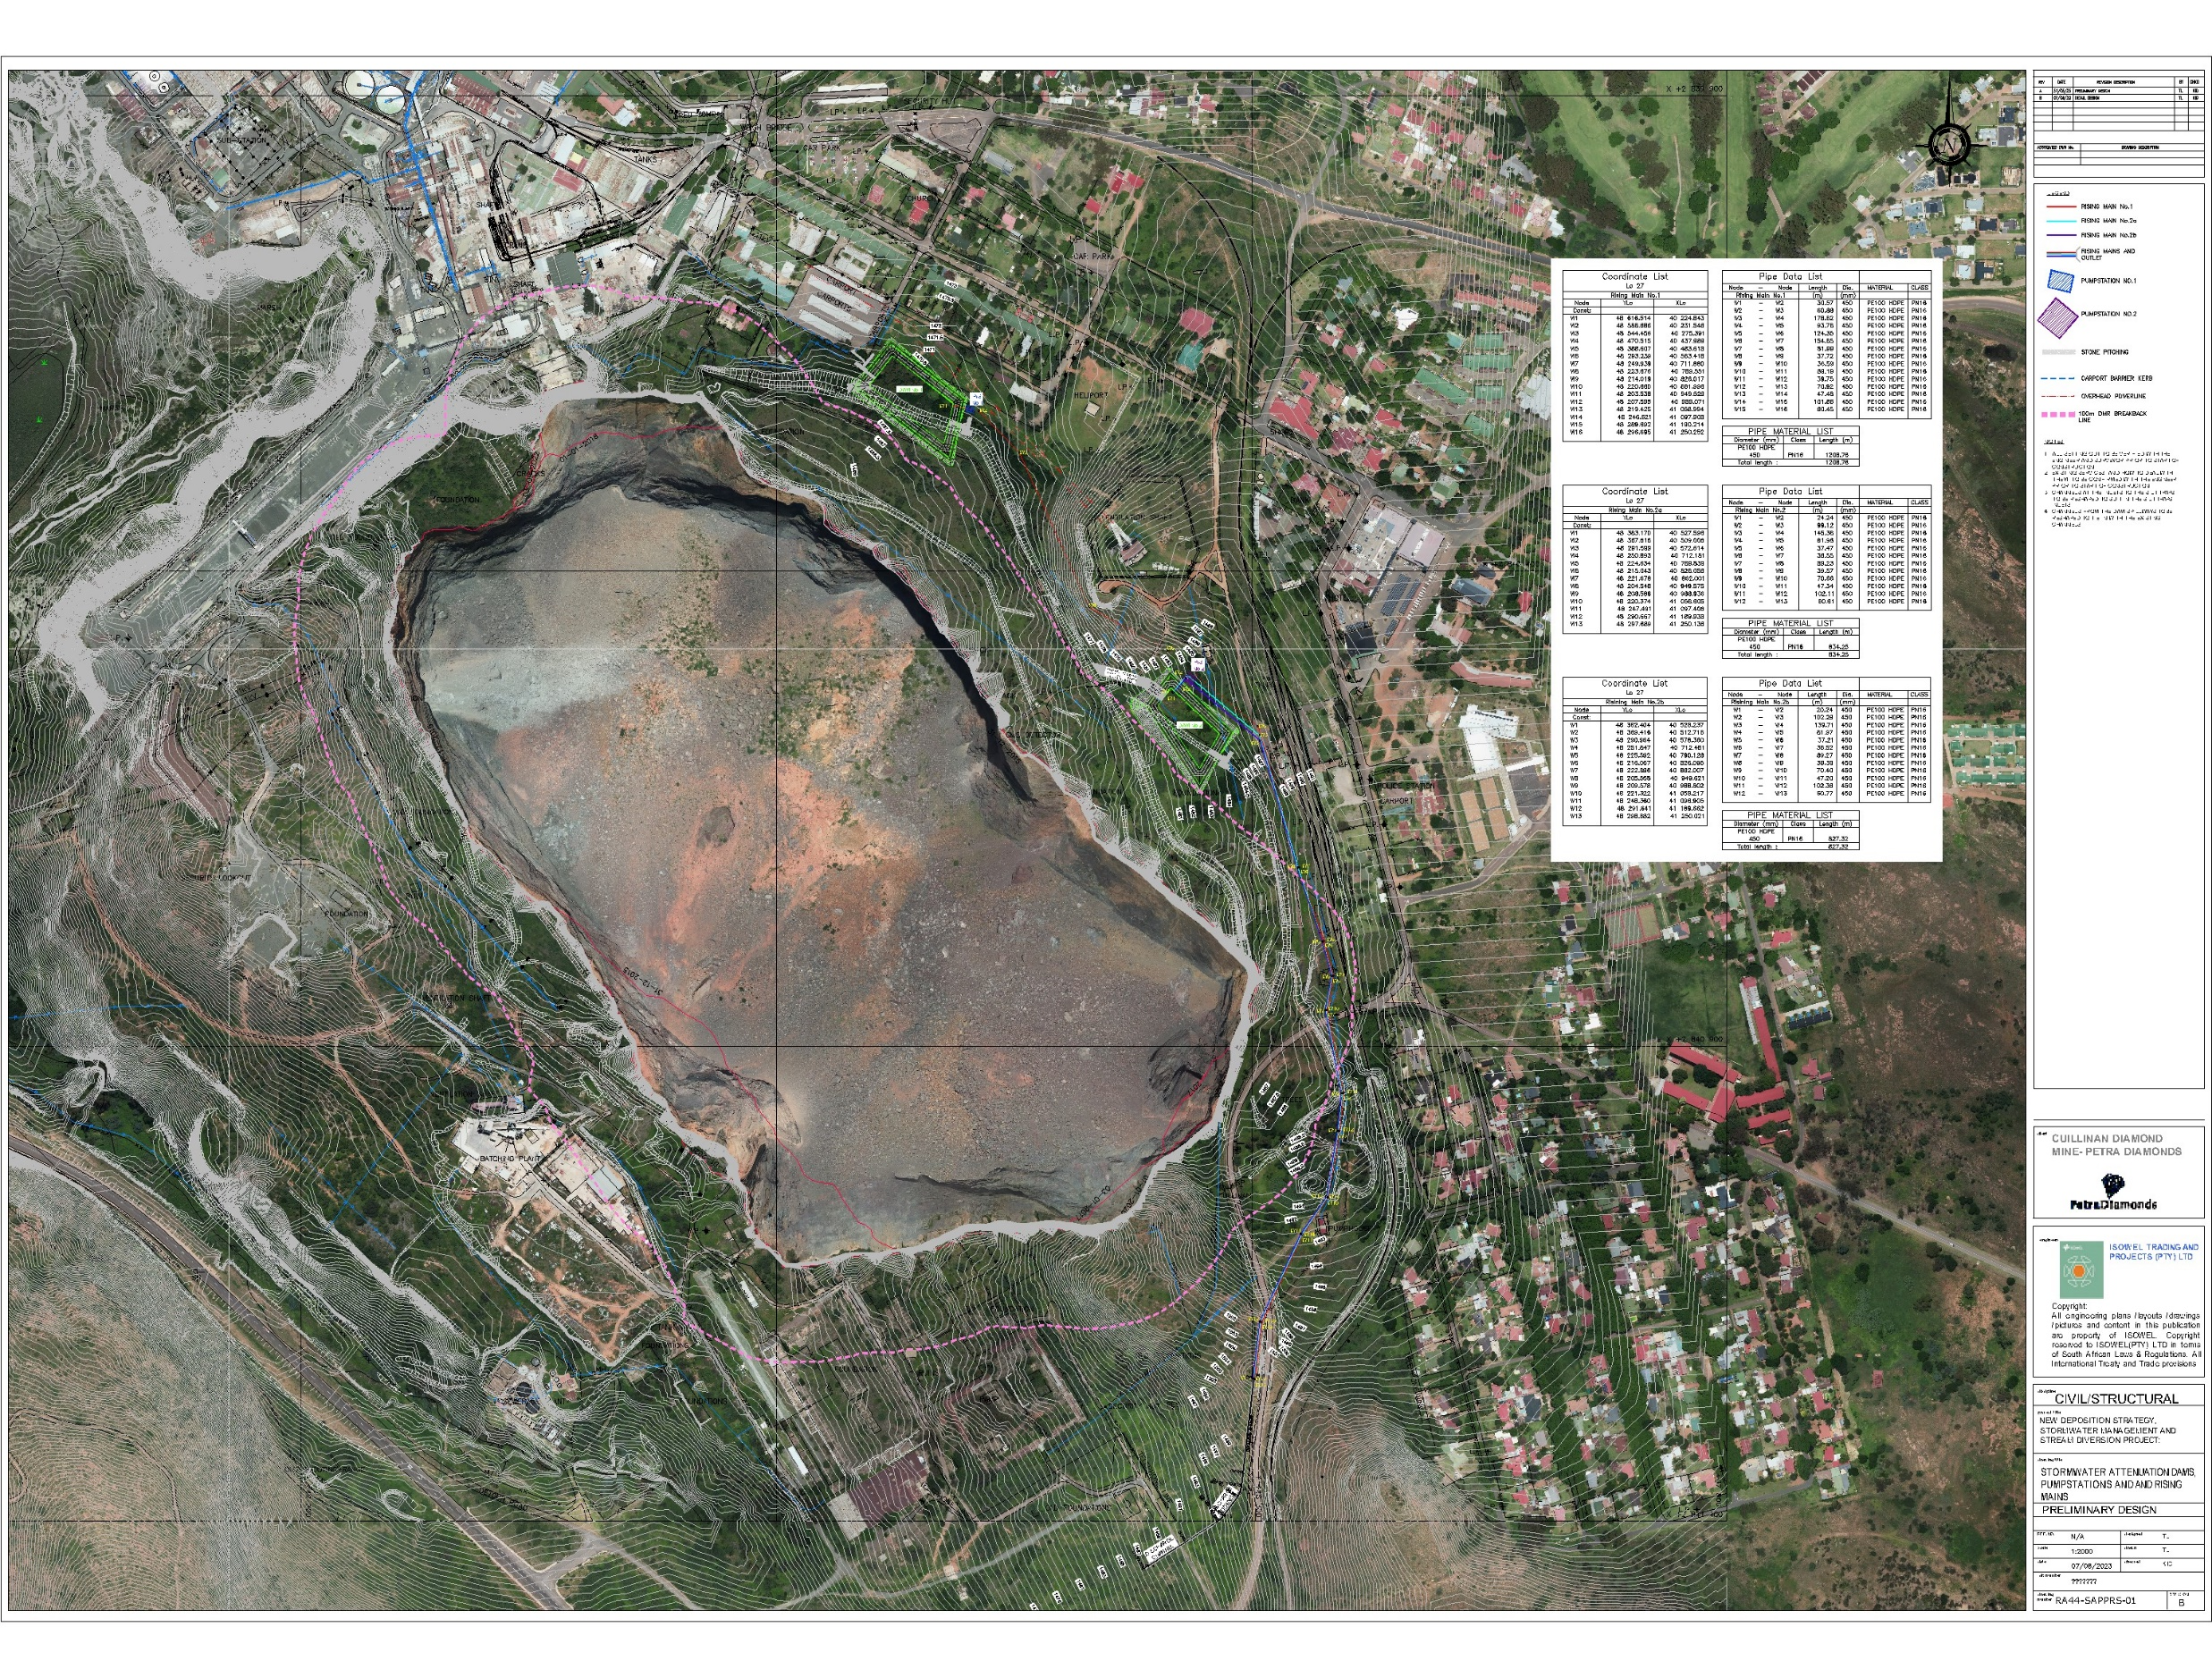
PROJECT DATA SHEET
PPC RIVER CROSSING AND CULLINAN MINE STORMWATER MANAGEMENT
CULLINAN MINE STORMWATER MANAGEMENT LAYOUT PLAN

