Slide 1

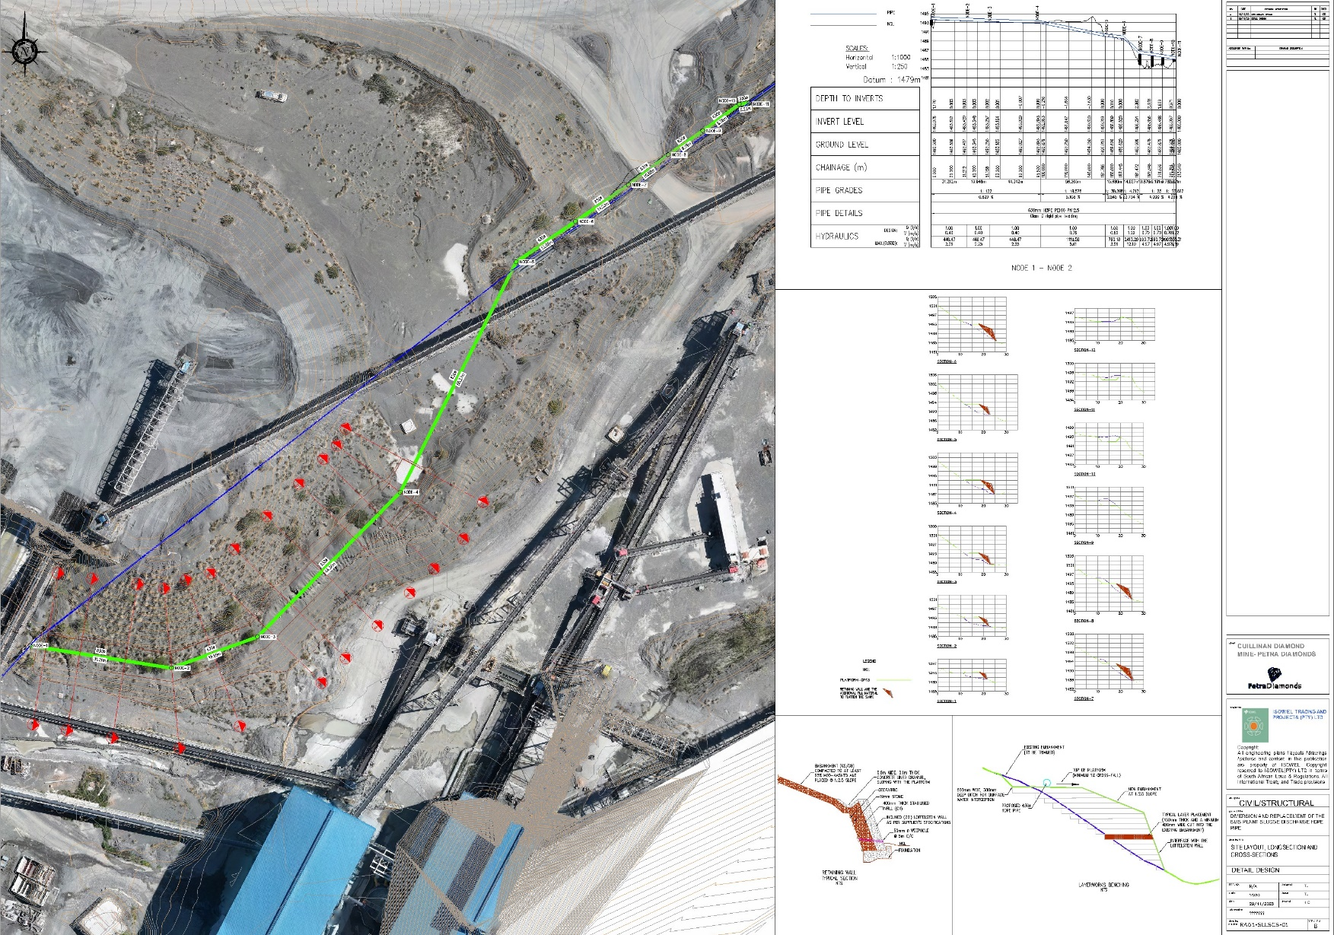
PROJECT DATA SHEET
CULLINAN MINE SLURRY PIPE DIVERSION
Client Details:
Name: Isowel Trading and Project
Contact Person: Moleseng Tlaila
Contact No.: 072 145 3735
Project Details:
Problem Statement:
An existing 710mm diameter slurry pipe which is 2km long is difficult to maintain as its spares are hard to find, and has a section which is buried by an embankment
Client Brief:
Preliminary, detail design and construction of a replacement pipe which is relatively easy to maintain and is also easily accessible.
The Solution:
Replace the 710mm diameter pipe with a 630mm HDPE and divert a section that is buried on a new platform and install a retaining wall.
Engineering Disciplines: Civil Engineering
Responsibilities: Engineering Designs and Technical Support during Construction
Location: Cullinan Mine in Gauteng
Project Value: R10 000 000.00
Project Duration: Six Months
Completed: Scheduled to be completed in May 2023
PIPELINE DIVERSION LAYOUT, PLATFORM, LONGSECTION AND CROSS-SECTION

