Slide 1

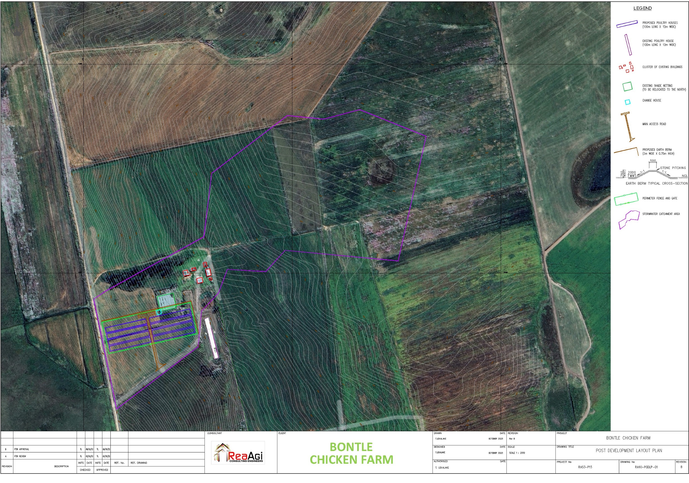
PROJECT DATA SHEET
BONTLE CHICKEN FARM
Client Details:
Name: Dudula Environmental
Contact Person: Maxwell Dudula
Contact No.: 083 531 6214
Project Details:
Problem Statement:
A requirement to expand the operations into poultry farming.
Client Brief:
A stormwater management plan that is required in support of a Water Use License Application.
The Solution:
A detailed Stormwater Management Plan
Engineering Disciplines: Civil Engineering
Responsibilities: Engineering Designs and Reporting
Location: Nigel, Gauteng
Project Value: R100 000.00 (Fees Only)
Project Duration: One Month
Completed: November 2023
BONTLE FARM SITE LAYOUT AND STORMWATER CATCHMENT AREA

