Slide 1

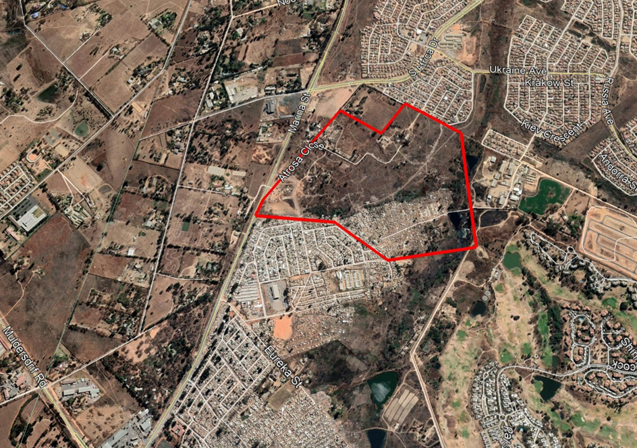
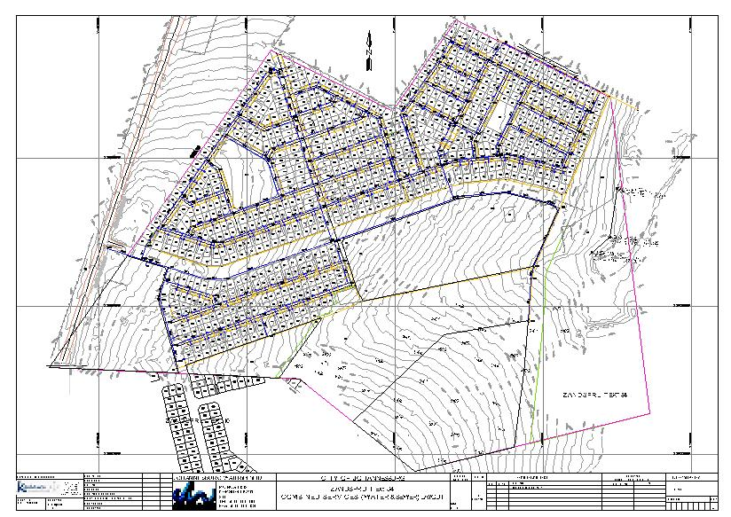
PROJECT DATA SHEET
ZANDSPRUIT EXT.84 BULK WATER & RETICULATION, AND BULK SEWER & NETWORK
Client Details:
Name: Kgalawu Consulting Engineers
Contact Person: William Sibanyoni
Contact No.: 011 972 0923
Project Details:
The Problem:
A new residential development in Zandspruit Extension 84, which comprises 703 individual stands and 2 065 high density residential units, required water and sanitation infrastructure.
Client Brief:
Preliminary and detail design of Bulk Water & Reticulation, and Bulk Sewer and its Network for the full development.
The Solution:
Optimised sizing and placement of all the required infrastructure, which is also accessible for both maintenance and operations. Software analysis was undertaken for the optimal design while complying with the minimum standards of the local authority.
Engineering Disciplines: Civil Engineering
Responsibilities: Engineering Designs
Location: Zandspruit Ext.84, Gauteng
Project Value: R47 486 262.74
Project Duration: Two Months (Design Only)
Completed: January 2020 (Design Only)
Locality Plan Water and Sanitation Design Layout

