Slide 1

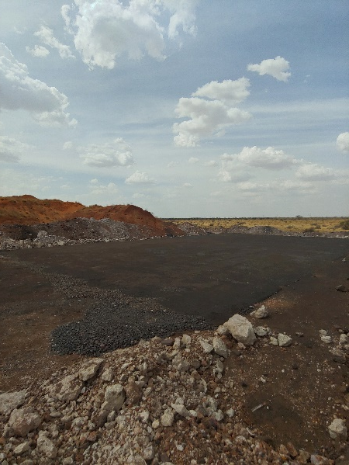
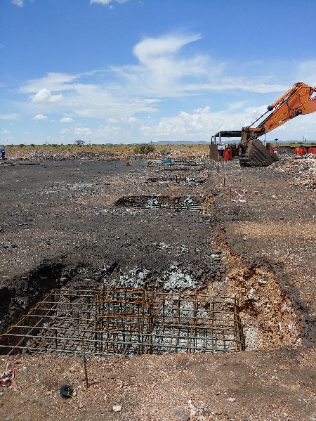
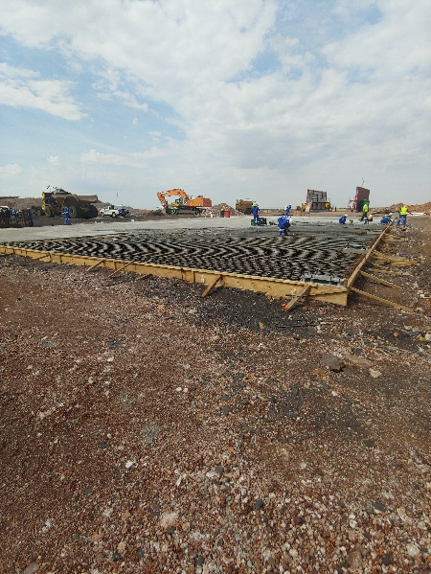
PROJECT DATA SHEET
PERTH MINE WORKSHOP CONCRETE SLAB
Client Details:
Name: Sebilo Resources
Contact Person: John Rutiri (Mine Manager)
Contact No.: 011 782 4322
Project Details:
Project Description: Maintenance Workshop Concrete Slab (43m by 28m by 0,3m thick), including bases for the future steel structure
Engineering Discipline: Civil (Multidisciplinary) Engineering
Earthworks
Structural Engineering
Stormwater Management
Oil Separation tanks
Responsibilities: Design, Procurement, Contract Administration and Project Management
Location: Perth Mine, Northern Cape
Project Value: R3 389 209,72
Project Duration: Three (3) Months
Completed: December 2019
Completed Platform Bases for Future Steel Structure Casting of Slab

