Slide 1

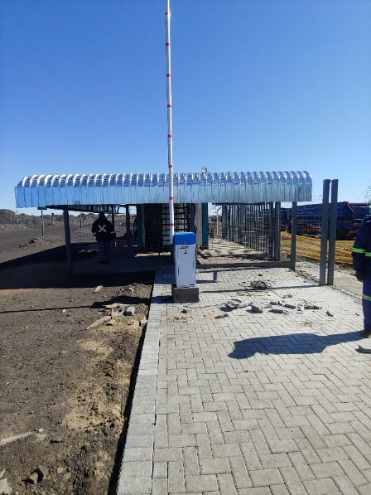
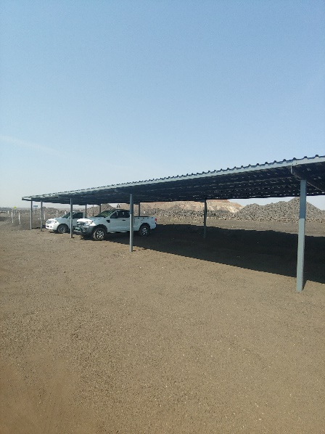
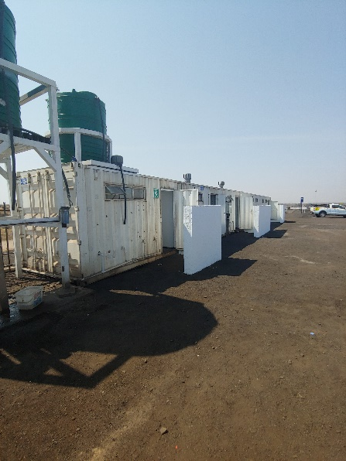
PROJECT DATA SHEET
PERTH MINE MAIN ENTRANCE AND OTHER FACILITIES UPGRADES
Client Details:
Name: Sebilo Resources
Contact Person: John Rutiri (Mine Manager)
Contact No.: 011 782 4322
Project Details:
Project Description: Upgrade of the Perth Mine Main Entrance, Water Reticulation, Shower Facilities and Ablution Facilities.
Engineering Discipline: Civil (Multidisciplinary) Engineering
Paving of Main Entrance
New Vehicle and Pedestrian Gates, including Fencing
Covered Pedestrian Walkway
Covered and Uncovered Parking Areas
Shower and Ablution Facilities
Water Reticulation and Sanitation Network
Responsibilities: Design, Procurement, Contract Administration and Project Management
Location: Perth Mine, Northern Cape
Project Value: R2 122 698,27
Project Duration: Three (3) Months
Completed: December 2019
Main Entrance Parking Shower and Ablution Facilities

