Slide 1

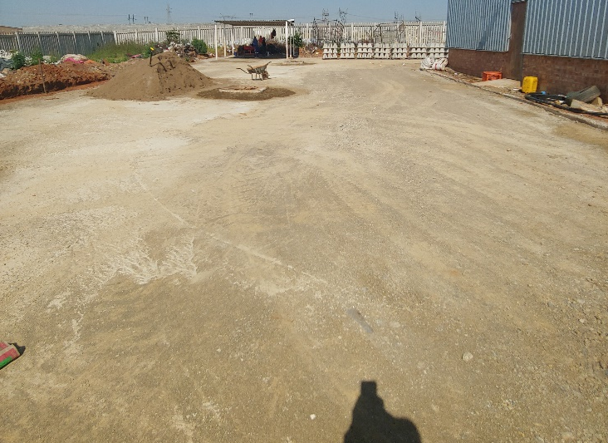
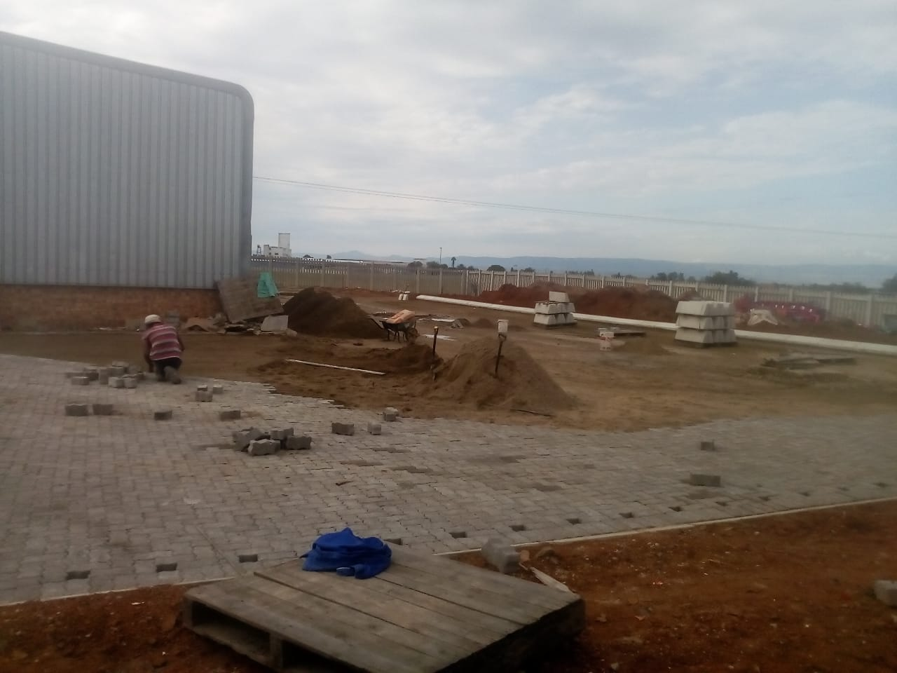
PROJECT DATA SHEET
NEWCASTLE BUY BACK CENTRE
Client Details:
Name: Dudula Environmental Consulting
Contact Person: Maxwell Dudula
Contact No.: 011 908 0152
Project Details:
The Problem:
The Newvastle Buy Back Centre, which receives waste collected by locals for recycling, was constructed but no parking, walkways and stormwater infrastructure around the facility were installed.
Client Brief:
Installation of the required paving, walkways and stormwater infrastructure for the new facility.
The Solution:
Earthworks, pavement and stormwater system design, and scheduling of the works to ensure minimal interference to the existing operations.
Engineering Disciplines: Civil Engineering
Responsibilities: Engineering Designs, Project Management, Construction Monitoring
Location: Newcastle, Kwazulu Natal
Project Value: R 800 000.00
Project Duration: Two Months
Completed: April 2020
Completed Base Layer Paving Underway

