Slide 1

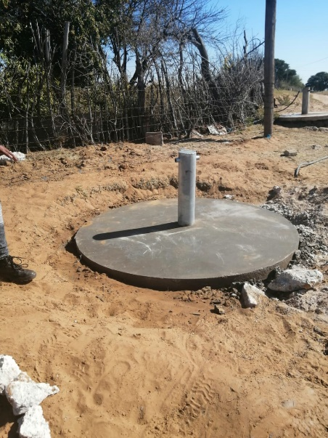
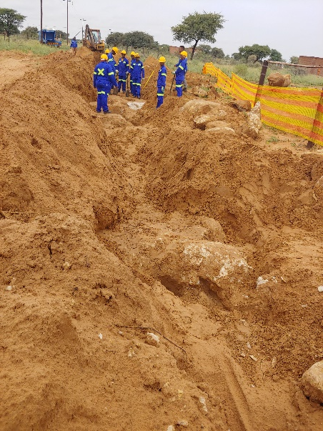
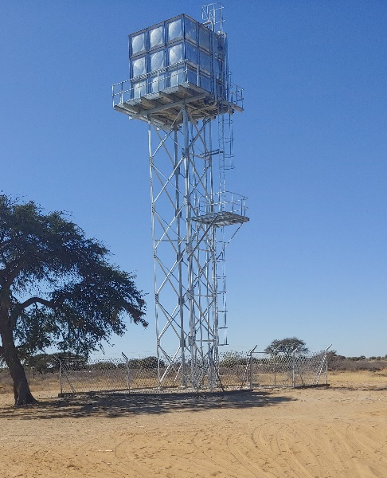
PROJECT DATA SHEET
GOODHOPE WATER RETICULATION
Client Details:
Name: Sebilo Resources
Contact Person: Lindelwa Plaatjie
Contact No.: 011 782 4322
Project Details:
Project Description: Goodhope water reticulation, including pumping from a borehole, storage and reticulation.
Engineering Discipline: Civil (Multidisciplinary) Engineering
Borehole refurbishment
Pump replacement
Pumphouse refurbishment
Rising Main
50kl Water Tank
3.5km of Water Reticulation
16 Communal Standpipes
Responsibilities: Prelim & Detail Design, Procurement and Contract Administration and Project Management
Location: Goodhope, Northern Cape
Project Value: R3 848 806.19
Project Duration: Four (4) Months
Completed: August 2020
Trench Excavation Communal Standpipe 50Kl Elevated Water Tank

