Slide 1

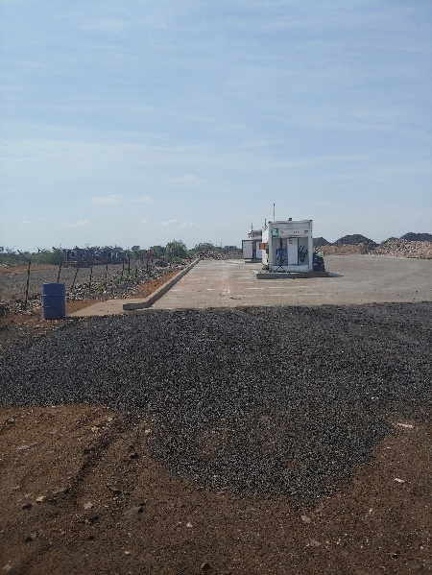
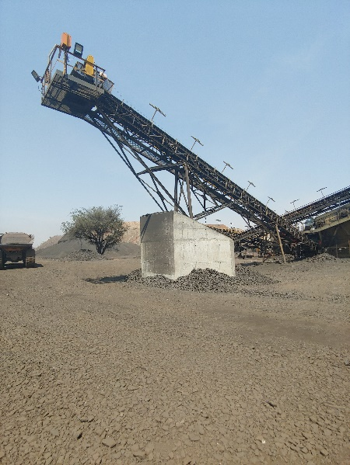
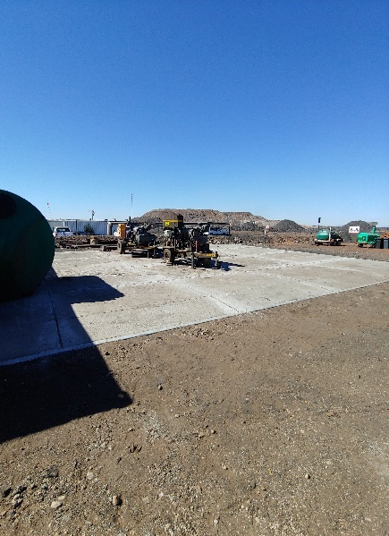
PROJECT DATA SHEET
PERTH MINE DIESEL REFUELING STATION CONCRETE SLAB & OIL SEPARATIONS TANKS, GENERAL WORK AREA CONCRETE SLAB & SUMP
AND CRUSHED MINERALS RETAINING WALLS
Client Details:
Name: Sebilo Resources
Contact Person: Danie Fourie (Mine Engineer)
Contact No.: 011 782 4322
Project Details:
The Problem:
Oil and other hydrocarbons at the diesel station and the general maintenance area were seeping into the ground, while loading of the crushed and screened material needed to be contained so that it could be loaded efficiently.
Client Brief:
Requirement for a solution to contain the oil and other hydrocarbons at the diesel station and the maintenance area, and a solution to allow for efficient loading of material at the crushing plant.
The Solution:
Concrete slabs were installed at the diesel station and the general work area to contain and channel all hydrocarbons to oils separation tanks from where they could be removed from site safely. Two concrete retaining wall were installed to contain and allow for efficient loading of material.
Engineering Disciplines:
Earthworks, Structural Engineering and Surface Water Management
Responsibilities: Project Management, Engineering Designs, Procurement, Construction Monitoring and Contract Administration
Location: Perth Mine, Northern Cape
Project Value: R4 647 866,76
Project Duration: Three (3) Months
Completed: December 2019
Diesel Station General Maintenance Area Crushed Material Retaining Wall

