Slide 1

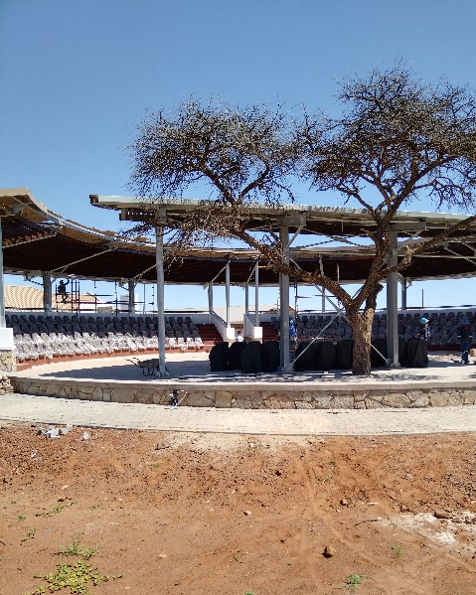
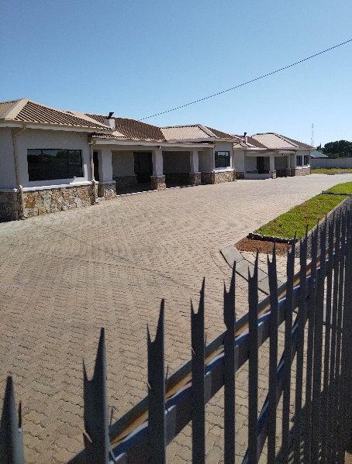
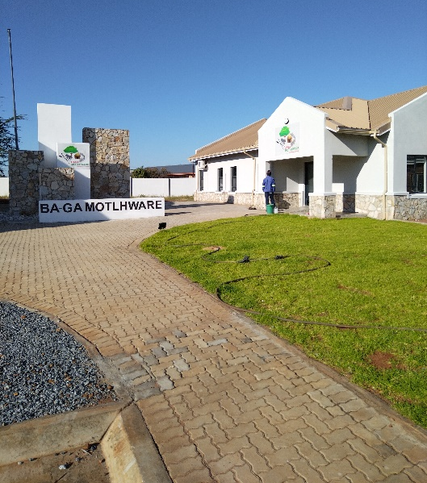
PROJECT DATA SHEET
BA-GA MOTLHWARE MIX-USE DEVELOPMENT
Client Details:
Name: Ba-Ga Motlhware Community Trust
Contact Person: Ogomoditswe Peter Toto
Contact No.: 079 026 9656
Project Details:
The Problem:
The tribal Kgotla, office and houses were old, some with limited functionality and has limited capacity for the proper operations of the Tribal Council.
Client Brief:
Construction of a New 230 capacity Kgotla, a new office and the demolition and reconstruction of three (3) residential houses, including but not limited to the required infrastructure like parking, water supply, power supply and sanitation.
The Solution:
Construction of the Earthworks, Kgotla, office block, housing units, parking, walkways, water supply, water pumpstation, sewer network, septic tanks, power supply and air-conditioning
Engineering Disciplines: Project Management, Civil Engineering, Structural Engineering
Responsibilities: Project Management, Engineering Designs, Procurement, Construction Monitoring and Contract Administration
Location: Batlharos, Northern Cape
Project Value: R 14 563 552.91
Project Duration: Eight Months
Completed: January 2022
Kgotla Housing Units Office Block

